Slide 1


WEB SCRAPING TO AI : A DATA DRIVEN JOURNEY FROM EXTRACTION TO DEPLOYEMENT
PROJECT : YOUR DOCTOR –
A SYMPTOM BASED
DISEASE PREDICTOR
TEAM : STRAW HATS
MEMBERS :
P.PRABHAS REDDY
D.SHYAM RAMAKRISHNA
B.KRISHNA CHAITANYA
D.GOWRI SHANKAR

Slide 2

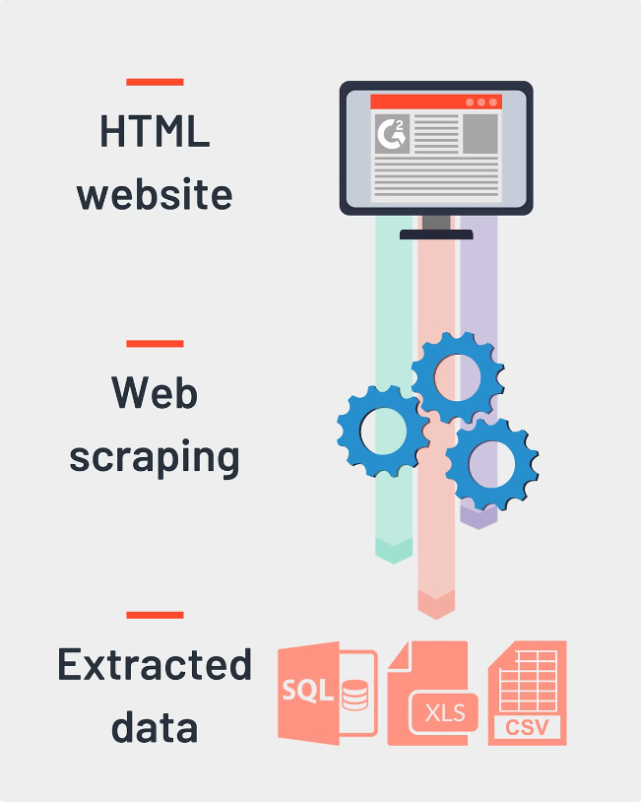
Phase 1: Web Scraping
1
Data Source: Wikipedia
The initial step involved extracting data from Wikipedia articles pertaining to diseases.
2
Web Scraping Tool: BeautifulSoup
BeautifulSoup was employed to parse the HTML content of Wikipedia pages and extract relevant information.
3
Data Collection: Symptoms, Causes, Risk Factors, Treatments
The scraping process targeted specific sections within Wikipedia pages to gather data on disease symptoms, causes, risk factors, and treatment options.

Slide 3

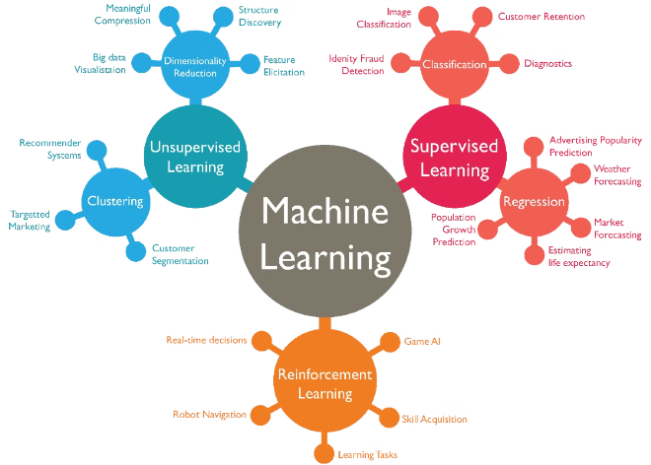
Phase 2: Model Training
1
Deep Learning Algorithm: Artificial Neural Network (ANN)
2
Model Training Process: Data Preprocessing, Feature Engineering, Model Selection
The extracted data was used to train an ANN model, which is a type of deep learning algorithm known for its ability to learn complex relationships within data.
The process involved cleaning the data, transforming it into suitable formats for the ANN, and selecting the optimal model architecture and hyperparameters.
3
Performance Metrics
4
Model Evaluation
The performance of the trained model was evaluated using key metrics, including training accuracy, testing accuracy, and loss value.
The model's performance was assessed on a separate dataset to evaluate its ability to generalize to unseen data.

Slide 4
Phase 3: User Interface
Streamlit
User Interaction
Model Prediction
Streamlit was chosen as the framework for building the user interface. It simplifies the process of creating interactive web applications.
The user interface allows users to input their symptoms, which are then processed by the trained model.
Based on the inputted symptoms, the model generates a prediction of the most likely disease, along with information about its causes, risk factors, and treatments.

Slide 5

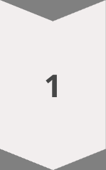
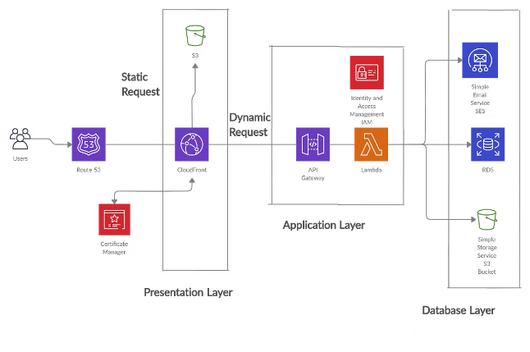
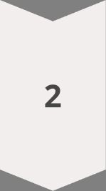
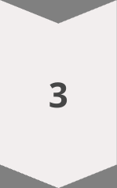
Phase 4: Deployment
Streamlit
The Streamlit application was deployed using Streamlit's deployment features.
TensorFlow
TensorFlow was used as the backend framework for the model, enabling the model to be loaded and used within the Streamlit application.
Cloud Platform
The application was hosted on a cloud platform to ensure accessibility and scalability.

Slide 6

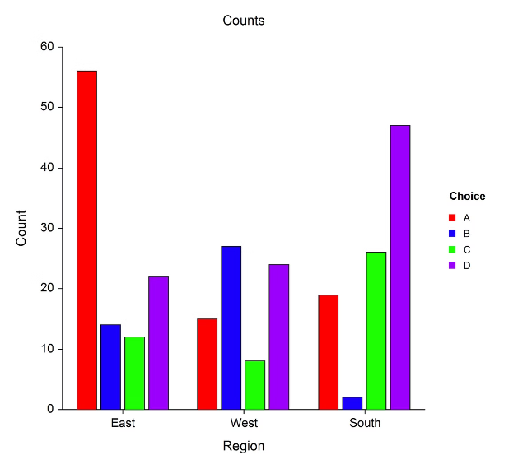
Model Performance Metrics
Training Accuracy
89.49%
Testing Accuracy
90.08%
Loss Value
0.23

Slide 7






Technologies Used
Python
TensorFlow
Python served as the primary programming language for this project, providing comprehensive libraries and frameworks for data manipulation, model training, and UI development.
TensorFlow, an open-source machine learning framework, facilitated the development and deployment of the ANN model.
BeautifulSoup
Streamlit
BeautifulSoup, a web scraping library, enabled the extraction of data from Wikipedia pages.
Streamlit was used to create the interactive web application, providing a user-friendly interface for interacting with the model.

Slide 8


Conclusion
The development of this disease prediction model demonstrates the potential of machine learning to assist in healthcare diagnosis. The model achieved promising accuracy and provides a foundation for further improvement.

